Slide 1
Integrated Coastal Zone Management
Unit 4: Stakeholder analysis

Slide 2
Introduction
Unit content
Understanding the meaning of ‘participation’ in coastal zone management
Defining stakeholders in the coastal zone
Grouping stakeholders
Participation and stakeholder groups
Learning outcomes
Upon completion of this unit, students will be able to
Understand the value of participation in management
Be aware of the criteria through which stakeholders are defined
Be able to categorize stakeholders by importance and influence
Understand how different forms of participation suit different stakeholder groups

Slide 3
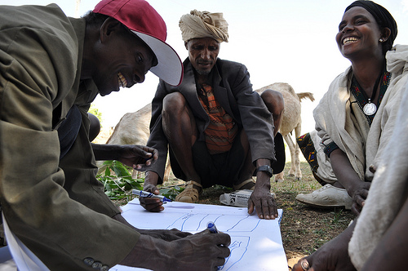
Participation
Participation:
Management make decisions
Those affected by decisions contribute actively to the decision-making process

Slide 4
Participation
Benefits of participation?

Slide 5
Participation
Benefits of participation
Transparency
Awareness of needs
Sense of ownership
Greater compliance
Trust
Communication
Sense of responsibility
Voluntary enforcement
Accountability
Knowledge-sharing
Sense of individual value
Better leadership

Slide 6
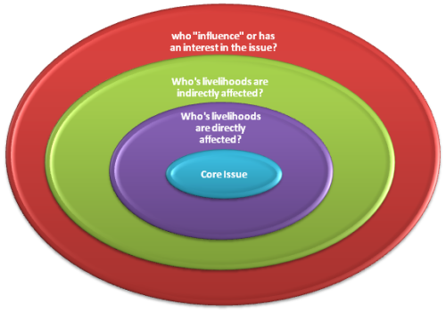
Stakeholders
Definition
‘any group or individual who can affect or is affected by the achievement of the organization’s objectives’
Who has an interest or influence in the issue?
Whose livelihoods are indirectly affected?
Whose livelihoods are directly affected?
ISSUE

Slide 7
Stakeholders
Definition
‘any group or individual who can affect or is affected by the achievement of the organization’s objectives’
Other stakeholders
Who has an interest or influence in the issue?
Secondary stakeholders
Whose livelihoods are indirectly affected?
Primary stakeholders
Whose livelihoods are directly affected?
ISSUE

Slide 8
Stakeholders
What examples can we think of in these groups?
Primary stakeholders
Secondary stakeholders
Other stakeholders
Fishers Fish consumers Fishery authorities
Hotel owners Tourists Travel agents
Charter boat owners Fuel providers Charter boat regulators
Mining companies Mining services providers Mining employment
agencies

Slide 9
Stakeholder ranking
How can we rank stakeholders?
Importance: impact of project on stakeholder
Influence: power of stakeholder over project success
1: very little importance/influence
5: very high importance/influence
 | Importance | Influence
Fishers
Fish consumers
Fishery authorities
Hotel owners
Tourists
Travel agents
Charter boat owners
Fuel providers
Charter boat regulators
Mining companies
Mining employment agencies
Mining regulators

Slide 10
Stakeholder grouping
How can we group stakeholders?
High
Importance (impact of
project on stakeholder)
Low
Low
Influence (power of stakeholder over project)
High

Slide 11
Stakeholder grouping
How can we group stakeholders?
High
High importance
Low influence
Example: fishers
High importance
High influence
Example: Government
Importance (impact of
project on stakeholder)
Low importance
Low influence
Example: General public
Low importance
High influence
Example: Local elite/media
Low
Low
Influence (power of stakeholder over project)
High

Slide 12
Stakeholder grouping
How does participation vary between groups?
High
High importance
Low influence
Example: fishers
Need extra initiatives to encourage participation
High importance
High influence
Example: Government
Good relationships essential for project success
Importance (impact of
project on stakeholder)
Low importance
Low influence
Example: General public
Little participation required
Low importance
High influence
Example: Local elite/media
Support important for project success
Low
Low
Influence (power of stakeholder over project)
High

